Slide 1
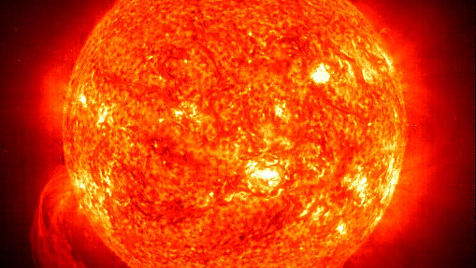
Nuclear Fusion as a Black Swan in the IIL Framework for Sustainable Energy
prof. SGH dr hab. Marcin J. Menkes
Sustainable Development as Fundamental Pillar of Economic Governance and Public Affairs
Ravenna, 9-10 November 2023

Slide 2
ENERGY GENERATION DRAMA, ACT I

Slide 3
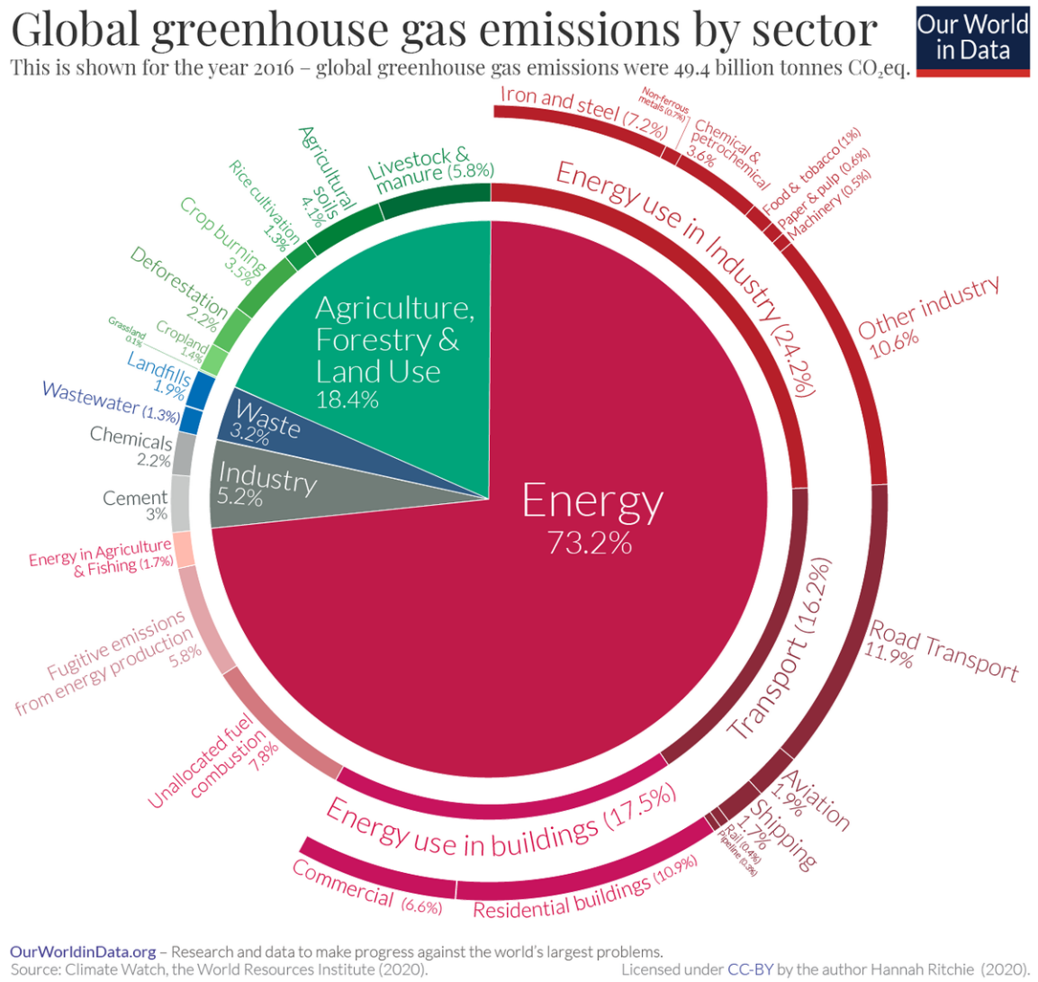
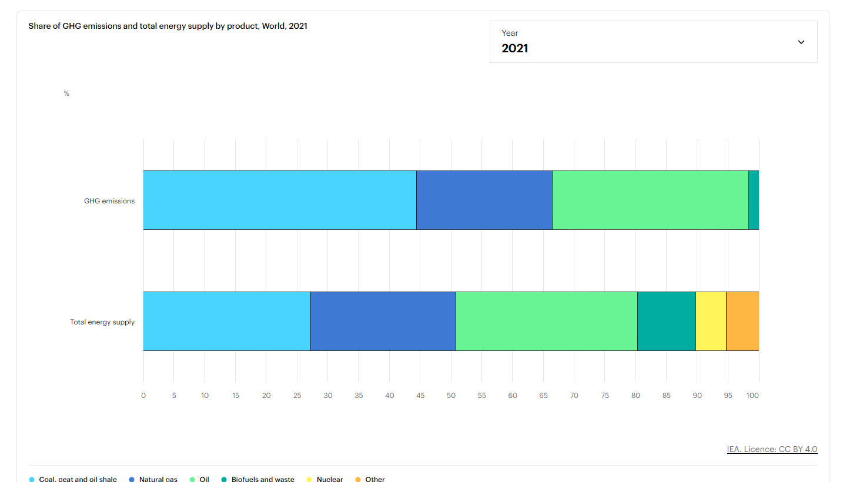
ENERGY GENERATION DRAMA, ACT II

Slide 4
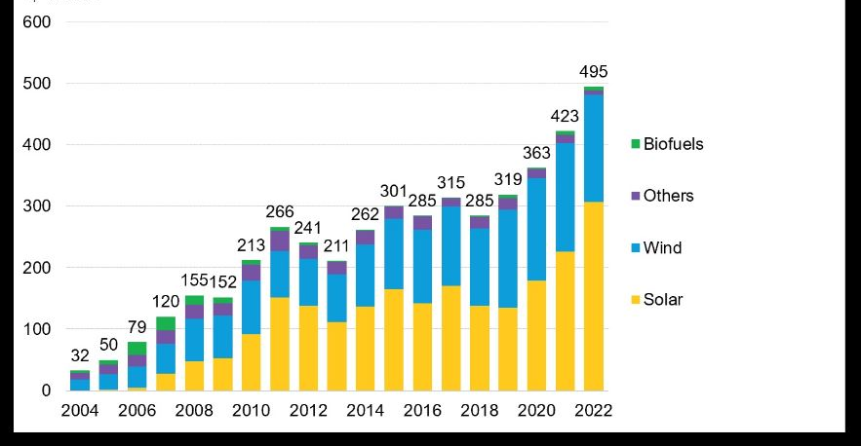
ENERGY INVESTMENT
Economic Factors: prices volatility, e.g. oil vs. natural gas.
Infrastructure Needs:
Aging Infrastructure
Expansion and Growth: Expanding access, urbanization
Energy Transition
Technological Advancements: energy storage, grid management, energy efficiency.
Consumer Preferences: including environmental & security
(Environmental) Policy Considerations:
Incentives: e.g. tax credits, subsidies, renewable energy targets, cap & trade
Regulations change-of energy mix, CO₂ caps, access to capital
(Energy) Security: diversification
Geopolitical Factors:
Access to resource Availability
Geopolitical Stability: Russia, Middle East.
Notes:
A Record $495 Billion Invested in Renewable Energy in 2022 | BloombergNEF

Slide 5
ENERGY ISDS DISPUTES
TECHNOLOGY
RISKS
Spanish wind subsidies phase-out
speculation
Pl 10h rule v. coal
socio-economic choice
Renewables revenue caps?
Right to regulate?
Dutch good faith coal fire generation pase-out
sustainability
Ger/Bel good faith & nuclear phase-out
risk profile
Fr nuclear CfD, Bel wind CRM?
Right to subsidise (though not too much)
but that’s ok
POLITICAL
RISKS
but that’s ok
BUSINESS
RISKS
but that’s ok

Slide 7
Risks v rewards
INPUT
Estimated R&D cost in the US alone $20 bn v federal financing at $700 M
OUTPUT
Technological risks
R&D on nuclear fusion since 1951, long R&D way to commercialization
cannibalistic with other technologies: SMRs, batteries, space energy?
Politcal risks
Safety implications? Environmental implications? Socioeconomic interests?
Vested interests in other energy-mix
Economic risks
Business interdependence between countries

